Slide 1
Clean Code, Software Design, and Refactoring
Dr. Jason B. Shepherd
https://pixabay.com/photos/london-underground-city-subway-2742625/

Slide 2
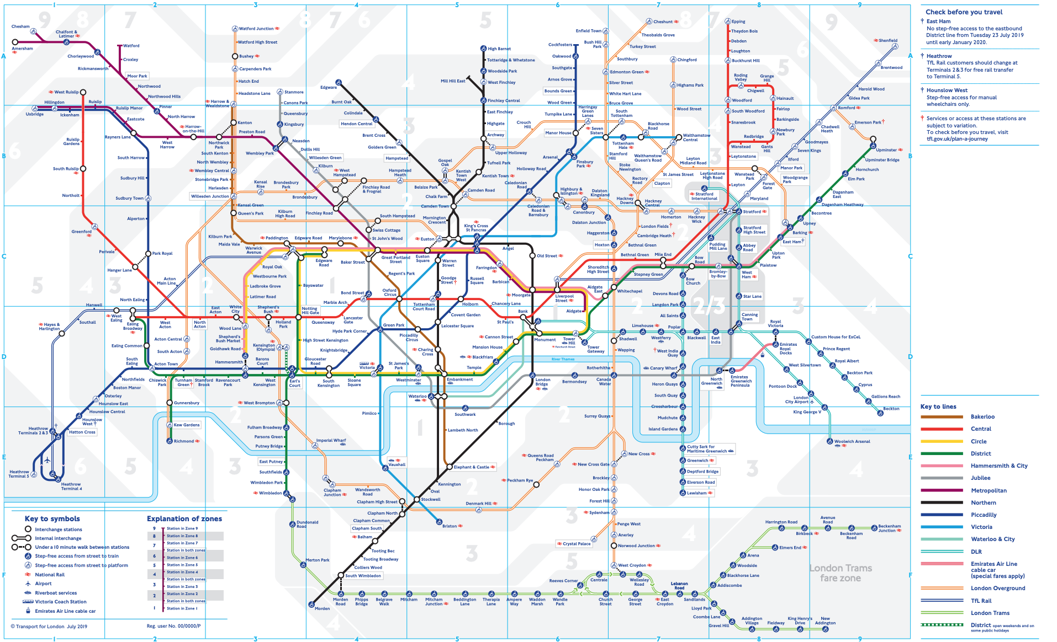

Slide 3
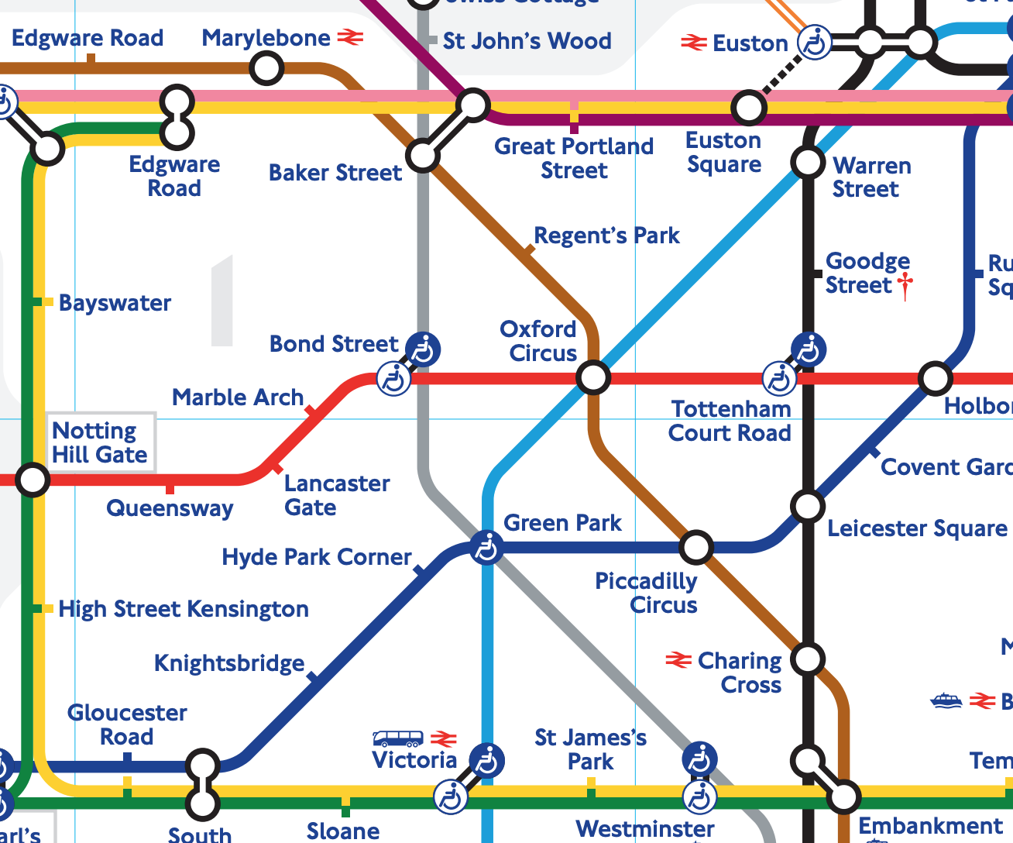

Slide 4
Overview
The role of code in software development
Coding conventions
OO in Python
“Shaping” code through design (design principles)

Slide 5
Requirements <--> Design <--> Code
Code is the “details of the requirements”
Requirements come from customers
Requirements are shaped by us through personas and user stories
Code is shaped through design
Designs evolve
Code must be refactored

Slide 6
The Total Cost of Owning a Mess
Release cycles stretch
Bugs not fixed in most recent release
Load times grow
Crashes
Product rushed to market

Slide 7
The Total Cost of Owning a Mess
No change is trivial anymore
Inevitable: the grand redesign by the “tiger team”
A short, interesting read: https://www.jwz.org/gruntle/nomo.html
A longer, interesting read: Clean Code by Robert C. Martin

Slide 8
Overview
The role of code in software development
Coding conventions
OO in Python
“Shaping” code through design (design principles)

Slide 9
Initial Remarks
Code is read much more than it is written
Variables should always be named the same way
Same with classes, functions, and files
Favor readable code over comments/documentation
… but comment/document where needed!
Eschew the use of black magic! (especially w/o comments)

Slide 10
Which is Better?
def make_user(*args):
f, l, classname = args
return eval(classname)(f, l)
def make_user(first, last, type_):
if type_ == 'Student':
return Student(first, last)
elif type_ == 'Faculty':
return Faculty(first, last)
else:
raise Exception('Unknown type "{}"'.type_)

Slide 11
PEP8 – A Style Guide for
Refer to class repo Reading Assignment Links → Coding Conventions.
I will not read this to you. You are responsible for reading PEP8.
Main ideas:
Naming conventions for variables, functions, class, and modules
Docstrings
Whitespace and indentation
Let a tool do the work.
pycodestyle
pip install pycodestyle (from with a virtual environment)
pycodestyle myfile.py
Vim (~/.vimrc)
set textwidth=79

Slide 12
Overview
The role of code in software development
Coding conventions
OO in Python
“Shaping” code through design (design principles)

Slide 13
First, Interactive Python
dir(☐) and help(☐)
☐.__dict__.keys()
☐.__doc__
def ☐():
''' This is what this function does.
For now all it does it pass.
'''
pass

Slide 14
A tour of OO Python, with turtles…
Classes
What’s really going on?
magic methods/dunders
Subclasses
Modules
PYTHONPATH

